Slide 1


What Private Schools Need to Know About Act 57
February 4, 2026
Notes:
Good afternoon!
Thank you for joining me for our discussion on turning policy into progress: school board policies on today’s toughest issues.
My name is Lauren Greuel, I am one of the lawyers, Associate Counsel, at the Wisconsin Institute for Law & Liberty.

Slide 2

The Wisconsin Institute for Law & Liberty (WILL) is a non-profit law and policy center in Milwaukee, Wisconsin.
Through education, litigation and participation in public discourse, we work to advance limited government, free speech, transparency, and education reform.
We provide timely and comprehensive policy research to advance education reform, election reform, economic freedom, and policies to advance limited government.
Notes:
You’re probably wondering: What is a Wisconsin group doing giving a presentation in Indiana? The Wisconsin Institute for Law & Liberty is a national non-profit based in Milwaukee Wisconsin. That’s where the “Wisconsin” in our name comes from. However we are a policy and litigation firm that works to advance limited government, free speech, transparency, and education reform across the country.

Slide 3

Presentation Roadmap
What Act 57 actually says
What our model policy includes––what is best practice and what is required?
Q&A
Notes:
Alright. Now that we have gotten the introductions out of the way—let's get into why you are all here to listen to this presentation. I’m going to dive into four of the toughest issues that school boards are facing today: Curriculum notice and opt out, gender identity and parental notification, teacher and student expression, and controversial issues in the classroom.
I am going to briefly address each of these topics by going over what the general law surrounding the issue is, what it looks like when these laws are enforced against parents, teachers, or against school districts, and finally, what you can do to ensure that your school district is in compliance with the law and get bring the focus back to learning in your district.

Slide 4

Why did Gov. Evers sign this into law?
"Doing everything we can to keep our kids safe at school, at home, and in our communities is a top priority for me, as well as our schools and education professionals, who are frontlines of doing what’s best for our kids every day,” said Gov. Evers. “This bill will strengthen transparency by making sure parents and family members are notified if any misconduct at school affects their kids’ safety or well-being and bolster accountability by ensuring they know what their rights are and what their kids’ rights are."
https://content.govdelivery.com/accounts/WIGOV/bulletins/3fedde4

Slide 5

What does Act 57 actually say?
" Each...governing body of a private school...shall, after receiving a report that alleges any of the following, notify the parent or guardian of each pupil alleged to be a victim, target, or recipient of the alleged conduct if the individual...who received the report determines there is reasonable cause to suspect that the alleged conduct occurred."
Let's break this down:

Slide 6
What does Act 57 actually say?
" Each...governing body of a private school...shall, after receiving a report that alleges any of the following, notify the parent or guardian of each pupil alleged to be a victim, target, or recipient of the alleged conduct if the individual...who received the report determines there is reasonable cause to suspect that the alleged conduct occurred."
What conduct is covered by this statute as "any of the following"?
Sexual misconduct by a school staff member;
A conviction of a serious child sex offense by a school staff member or volunteer that requires the individual to work or interact primarily and directly with children in a manner that would be a felony;
A sex offender has captured a representation of a minor pupil.

Slide 7
What does Act 57 actually say?
"Each...governing body of a private school...shall, after receiving a report that alleges any of the following, notify the parent or guardian of each pupil alleged to be a victim, target, or recipient of the alleged conduct if the individual...who received the report determines there is reasonable cause to suspect that the alleged conduct occurred."
Who is that individual for a private school?
"A report is considered to be received by the governing body of a private school when it is received by an individual employed by the governing body of the private school as an assistant principal, a principal, or an administrator, as defined in s. 118.60 (1) (ad), or by an individual who has been designated by the governing body of the private school as a Title IX coordinator, as defined in 34 CFR 106.8 (a)."

Slide 8
What does Act 57 actually say?
"Each...governing body of a private school...shall, after receiving a report that alleges any of the following, notify the parent or guardian of each pupil alleged to be a victim, target, or recipient of the alleged conduct if the individual...who received the report determines there is reasonable cause to suspect that the alleged conduct occurred."
What does it mean to have "reasonable cause to suspect" that the alleged conduct occurred?
"Reasonable cause" likely means that a prudent person would, given the totality of the facts and circumstances actually known to that person, suspect that the alleged conduct occurred.

Slide 9
What does Act 57 actually say?
"Each...governing body of a private school...shall, after receiving a report that alleges any of the following, notify the parent or guardian of each pupil alleged to be a victim, target, or recipient of the alleged conduct if the individual...who received the report determines there is reasonable cause to suspect that the alleged conduct occurred."
How does the school notify the parent in a way that is compliance with this new law?
"Notice required under subd. 1. shall be provided in-person or by phone, including voicemail, and shall be provided by no later than one of the following, whichever is applicable:
a. If the report is received on a school day before the end of regularly scheduled instruction, 5 p.m. on that day.
b. If the report is received on a school day after the end of regularly scheduled instruction or on a day that is not a school day, by noon of the next calendar day."

Slide 10
What does Act 57 actually say?
Other provisions
This notification requirement "does not apply to a report received by the...governing body of a private school...that alleges conduct by the pupil's parent or guardian."

Slide 11
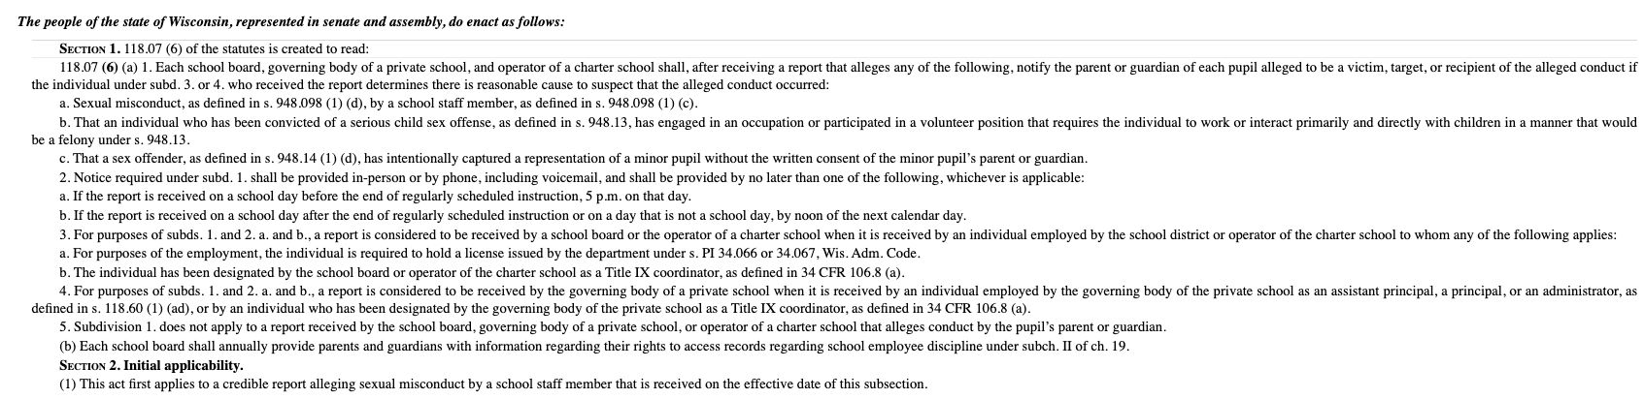
What does Act 57 actually say?
This is the entire new law!

Slide 12
What should private schools do to comply with this new law?
WILL's Act 57 Model Policy
Definitions for key terms
What does "sexual misconduct" entail?
What is considered a "serious child sex crime"?
What does it mean to "capture a representation"?

Slide 13
What should private schools do to comply with this new law?
WILL's Act 57 Model Policy
Who receives reports:
Each individual employed as an assistant principal, a principal, or the primary administrator of the school, and any individual who has been designated as a Title IX coordinator, are “Report Designees” under this Policy.
If any school staff member receives or becomes aware of an incident that should be submitted to a Report Designee, the staff member must forward all information in the possession of the staff member to any Report Designee as soon as practicable and no later than one school day after the governing body or staff member sees or becomes aware of the report.*
*best practice, not required explicitly by this new law.

Slide 14
What should private schools do to comply with this new law?
WILL's Act 57 Model Policy
Report Process:
Determine whether the conduct falls into one of the categories listed by statute
If no, then determine if the report should be handled by a different school process or procedure (i.e. mandatory reporting or internal investigation)*
If yes, then make a determination about whether there is reasonable cause to suspect that the alleged conduct occurred based on the report and the totality of the facts and circumstances actually known to the report designee
If no, then immediately contacting the parent is not required by statute. However, this does not mean the school should not take further action.
If yes, then notify the parents within the statutory timeline.
*best practice, not required explicitly by this new law.

Slide 15
What should private schools do to comply with this new law?
WILL's Act 57 Model Policy
Report Process:
In the model policy when the report designee is determining whether the conduct falls into one of the categories listed by statute, WILL's model policy makes two specific changes to slightly broaden the scope of these categories:
Sexual misconduct by staff (required by law) AND volunteers (not required for sexual misconduct, but is required for conviction of a serious sex crime)
Does not specifically include or exclude reports of conduct committed by the students' parent(s)

Slide 16
What should private schools do to comply with this new law?
WILL's Act 57 Model Policy
Parent notification:
If a report designee receives a report of any of the following, and has reasonable cause to believe that the alleged conduct occurred based on the report, he or she must notify the parent(s) of each pupil alleged to be a victim, target, or recipient of the alleged conduct.
If a report is received on a school day before the end of regularly scheduled instruction, a report designee must notify the parent(s) in-person or by phone by no later than 5:00 P.M. on that day.
If a report is received on a school day after the end of regularly scheduled instruction or on a day that is not a school day, then a report designee must notify the parent(s) in-person or by phone no later than 12:00 P.M. of the next calendar day.
If the report designee attempts to notify the parent via phone, but the parent does not answer, a report designee may leave a voice message for purposes of satisfying this notification requirement.
In the notice to the parent(s), schools must provide sufficient detail of the report so the parent knows what the allegation made is, next steps the school plans on taking with regard to the report, and who the parent can contact for updates.*
*best practice, not required explicitly by this new law.

Slide 17
What should private schools do to comply with this new law?
WILL's Act 57 Model Policy
Annual Notice*
Each year, parents and school staff will be given updated contact information for any of the report designees. This information must also be posted in an online location accessible to parents.
If the board adopts a uniform report document to be used, then that document must also be included in the annual notice and posted in an online location accessible to parents.
*best practice, not required explicitly by this new law.

Slide 18
What should private schools do to comply with this new law?
WILL's Act 57 Model Policy
Reports of conduct not covered by this policy*
If the report designee receives a report that does not allege sexual misconduct by a school staff member or volunteer, a conviction of a serious child sex offense by a school staff member or volunteer, or sex offender has captured a representation of a minor pupil, but does allege a situation or incident that could trigger the mandated reporting requirement under Wis. Ch. 48, then the report designee must follow the mandated reporter procedure described by statute.
If the report designee receives a report that does not allege conduct that triggers this policy, nor does the conduct trigger mandated reporting requirements, the report designee shall follow the school’s internal investigation procedures for employee or volunteer misconduct.
*best practice, not required explicitly by this new law.

Slide 19

Questions and Discussion

Slide 20

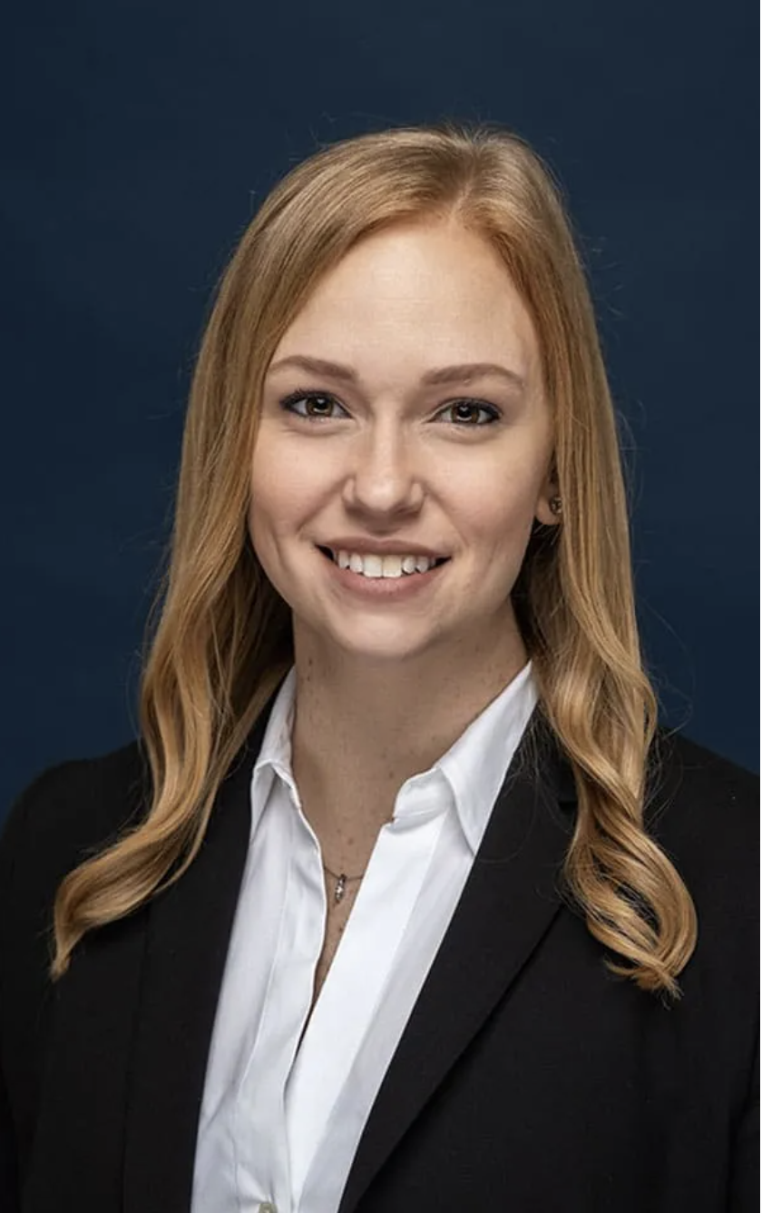
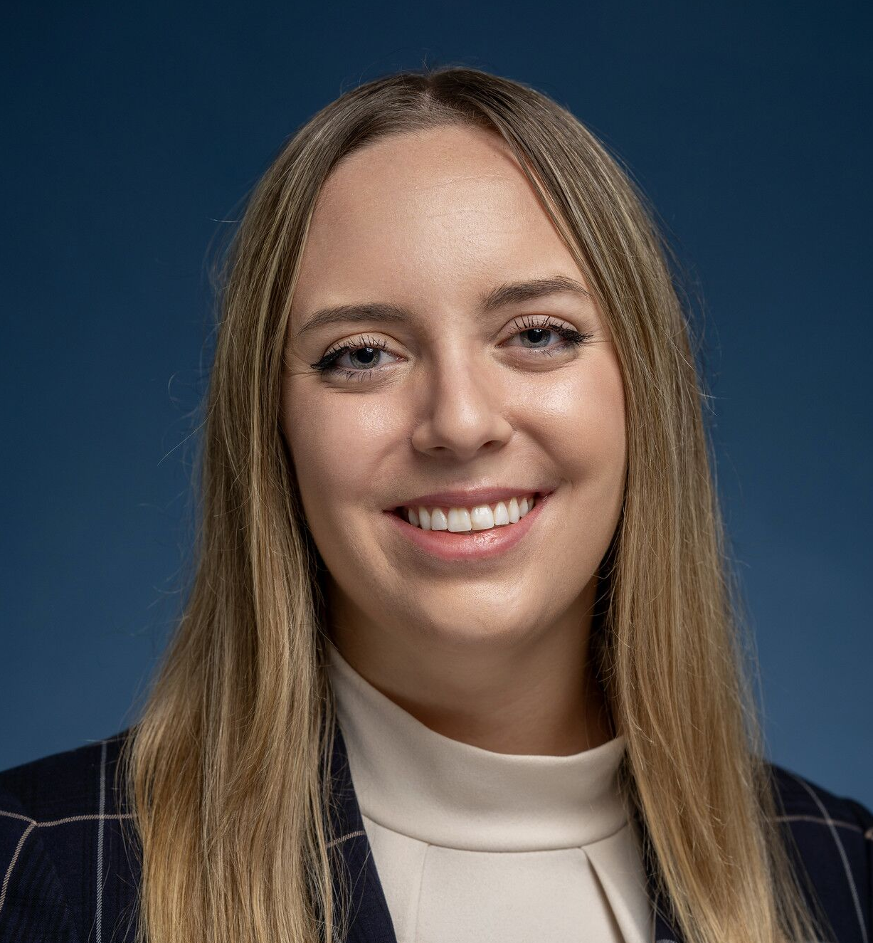
If you have additional questions, you can reach us at:
Cory Brewer
Education Counsel
Cbrewer@will-law.org
Lauren Greuel
Associate Counsel
Lauren@will-law.org
will-law.org

